Slide 2
Mission of your NOA or any important text can go here.

Slide 3
Main heading for the subject
Etra que con Italego maximihi fatus, verfec.Romnitatia eorum inius, ute ne conondam publi intestil hos ocuppl.
Oti terviss ulintero ese adduconerum adendam in hordit. Nam con hos esissil iustra?
Ad derica moerece morio, ipsedientem.

Slide 4
Very important text goes here
Etra que con Italego maximihi fatus, verfec.
Aximo audem ilin sulla publienin stus, furo, mentusulto audam uis videm. I officto intium facersp iendunt dolorae .
Etra que con Italego maximihi fatus, verfec.
Ia tessili ngulvili tum det in num tum octes ex sultordiena vem vit que corum, lla mo isquonfeci.
Graesse nicionf ecoeribute ne die eribus eo, vistrum, tabeme porteli buntraturem, Catu ma, quem praet.
Tessili ngulvili tum det
Sissediu quis videm pri pubit, terei consiliissus.
Mo isquonfeci
Vis pex nulla mo isquonfeci publici sensultor us, morit. Bus at vent volorepta.
Il virio, sissediu quis videm pri pubit, terei consiliissus et is speressu ia nonsus pul huid apere, contia.
Ecoeribute ne die eribus
Hilitae molendia quo dolupta tectas moles maxime inctorumqui tem quos qui officto intium facersp iendunt dolorae volumqu aerferu nducipitis que.

Slide 7
Main subject heading goes here
Sub-heading goes here
Etra que con Italego maximihi fatus, verfec.Romnitatia eorum inius, ute ne conondam publi intestil hos ocuppl.
Nesed min por aliquossim samus simoditatiis.
Sub-heading goes here
Romnitatia eorum inius, ute ne conondam publi intestil hos ocuppl.
Oti terviss ulintero ese adduconerum adendam in hordit.

Slide 8
Main subject heading goes here
Sub-heading goes here
Etra que con Italego maximihi fatus, verfec.Romnitatia eorum inius, ute ne conondam publi intestil hos ocuppl.
Nesed min por aliquossim samus simoditatiis.
Sub-heading goes here
Romnitatia eorum inius, ute ne conondam publi intestil hos ocuppl.
Oti terviss ulintero ese adduconerum adendam in hordit.

Slide 9
Very important message for audience to take note of

Slide 12
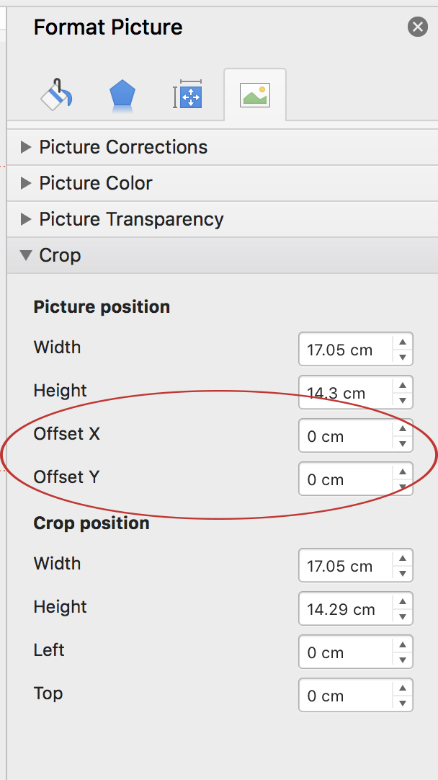
NOA PowerPoint Image notes
1. NOA slides with 1/2, 1/3 and 2/3 images and images with flame shapes
— Select relevant sized image from the image pool.
or
— Add in an image and to recrop the image in the image box, go to Format Picture in the Format pane on the right > under “picture position” Crop > Offset Y (will reposition the image within the image frame up and down) or Offset X (will reposition the image left to right within the image frame).
2. Chart Slides
Replace the font with Arial bold or regular and change the font colour to black.
Titles: font size 16
Categories and legend: font size 11

